Slide 1
CNN-Based Diagnostic System for Diabetic Foot Ulcer Analysis

Slide 2
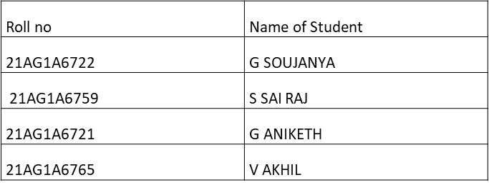
Major Project Stage 1 Review Presented by
UNDER THE SUPERVISION OF
Mrs. A. Sarala Devi,
Associate professor
CSE(Data Science)
ACE ENGINEERING COLLEGE

Slide 3
Contents
Introduction
Literature Survey
Existing System
Proposed Model
Software and Hardware Requirements
Functional and Non-Functional Requirements
System Analysis
Conclusion
Bibliography

Slide 4
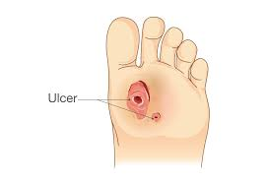
Introduction
Diabetic Foot Ulcer (DFU) is a serious complication of diabetes that affects approximately 15-25% of diabetic patients globally.
If untreated, it can cause infections, gangrene, and amputations, significantly increasing mortality rates.
Manual inspection by doctors is time-consuming and subjective, while AI-based deep learning models improve accuracy and efficiency in early detection.
Timely diagnosis and treatment reduce complications, enhance patient care, and prevent severe health consequences.

Slide 5
Existing System
Podiatrists or healthcare professionals visually inspect ulcers, which is time-consuming and prone to subjective variations.
Methods like X-rays, MRI, and thermography help assess ulcer depth and infection severity but require expert interpretation and specialized equipment.
Some existing automated systems use handcrafted features and conventional machine learning techniques (e.g., SVM, Random Forest), which have limited accuracy and generalization capabilities.

Slide 6
Limitations of Existing System
Manual inspection by medical experts is slow and varies based on the experience of the clinician, leading to inconsistent diagnoses.
Traditional machine learning models rely on handcrafted features, which may not capture complex ulcer patterns, reducing classification accuracy.
Techniques like MRI and thermography require expensive equipment and trained professionals, making them less accessible for remote or low-resource settings.
Due to the reliance on manual inspection and limited automation, early-stage ulcers may go undetected, increasing the risk of infections and amputations.

Slide 7
MobileNetV2-Based DFU Classification
Utilizes MobileNetV2 as a lightweight and efficient convolutional neural network backbone, enabling fast and accurate binary classification of diabetic foot ulcer (DFU) images.
Data Augmentation for Robustness
Applies image augmentation techniques (rotation, zoom, shear, flipping) to enhance model robustness against real-world variability in ulcer image appearance.
Expert-Annotated Dataset
Trains on a medical expert-verified DFU image dataset to ensure trustworthy labeling and model reliability in clinical scenarios.

Slide 8
Development Environment: Jupyter Notebook/VS Code for writing & testing the code interactively.
Operating System: Windows 10 or later
Programming Languages: Python
Libraries and Frameworks:
TensorFlow / Keras – For building, training, and deploying deep learning models.
Pandas – For managing and analyzing datasets.
scikit-learn – For implementing ML-based preprocessing techniques..
Matplotlib / Seaborn – For visualizing dataset distributions and model performance.

Slide 9
Hardware Requirements
Processor (CPU): Quad-core processor (Intel i5 or AMD Ryzen 5)
RAM: Minimum 8 GB or higher
Storage: Minimum: 256 GB SSD (to store datasets, models, and related files)
Internet Connection: A stable and fast internet connection for downloading datasets, libraries, and pre-trained models.

Slide 10
Functional & Non-Functional Requirements
Functional Requirements:
The system should detect the presence of foot ulcers using images
The system should detect the normal healthy foot as non-ulcer.
The system provides diet plan and medications suggestions for the ulcer detected patients.
Non-Functional Requirements:
Performance
Scalability
Availability
Maintainability

Slide 11
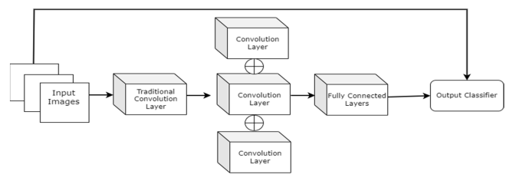
System Architecture

Slide 12
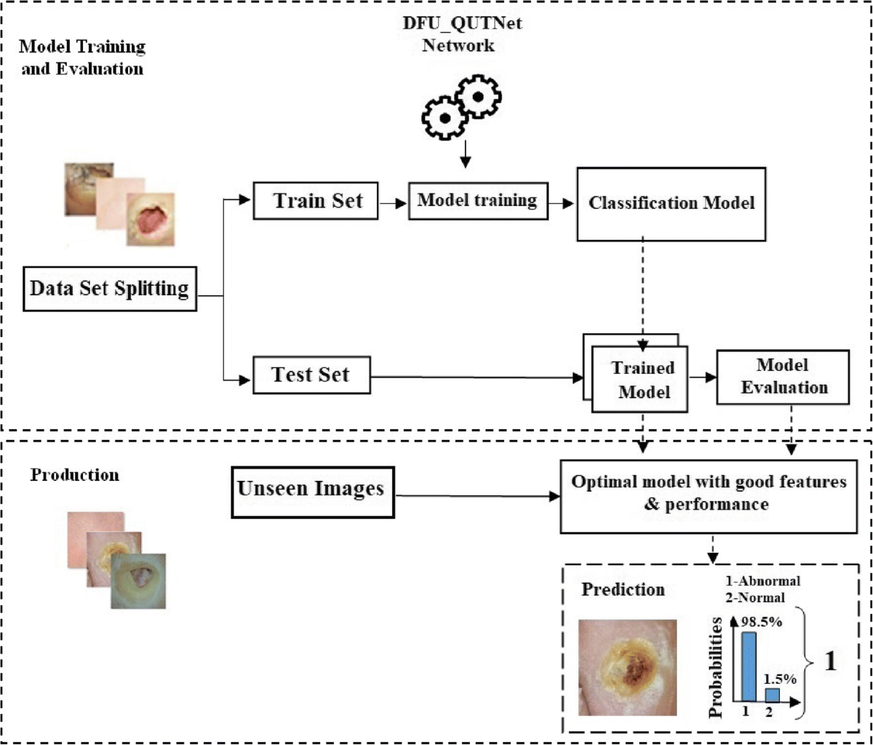
System Analysis

Slide 13
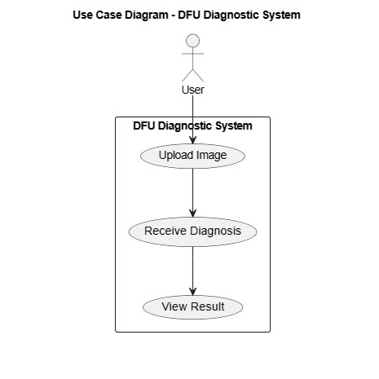
Use Case Diagram

Slide 14
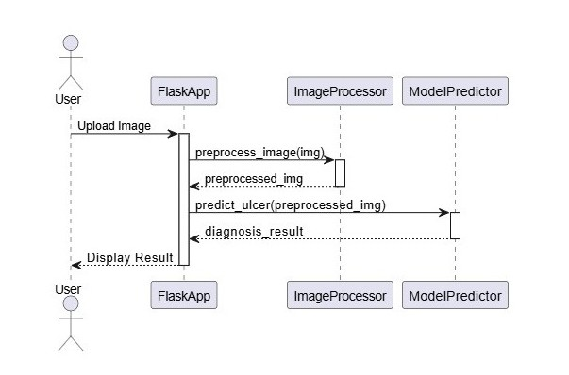
Sequence Diagram

Slide 15
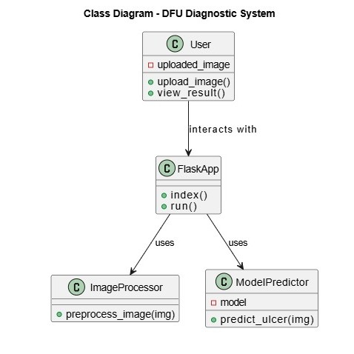
Class Diagram

Slide 16
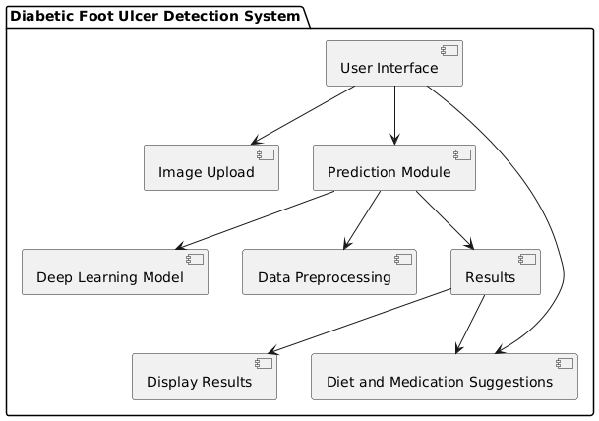
Component Diagram

Slide 17
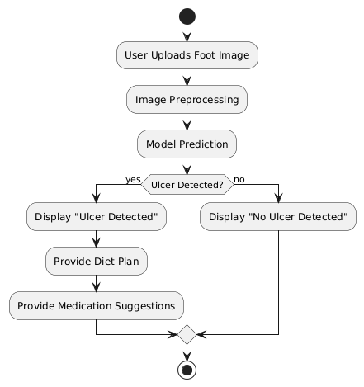
Activity Diagram

Slide 18
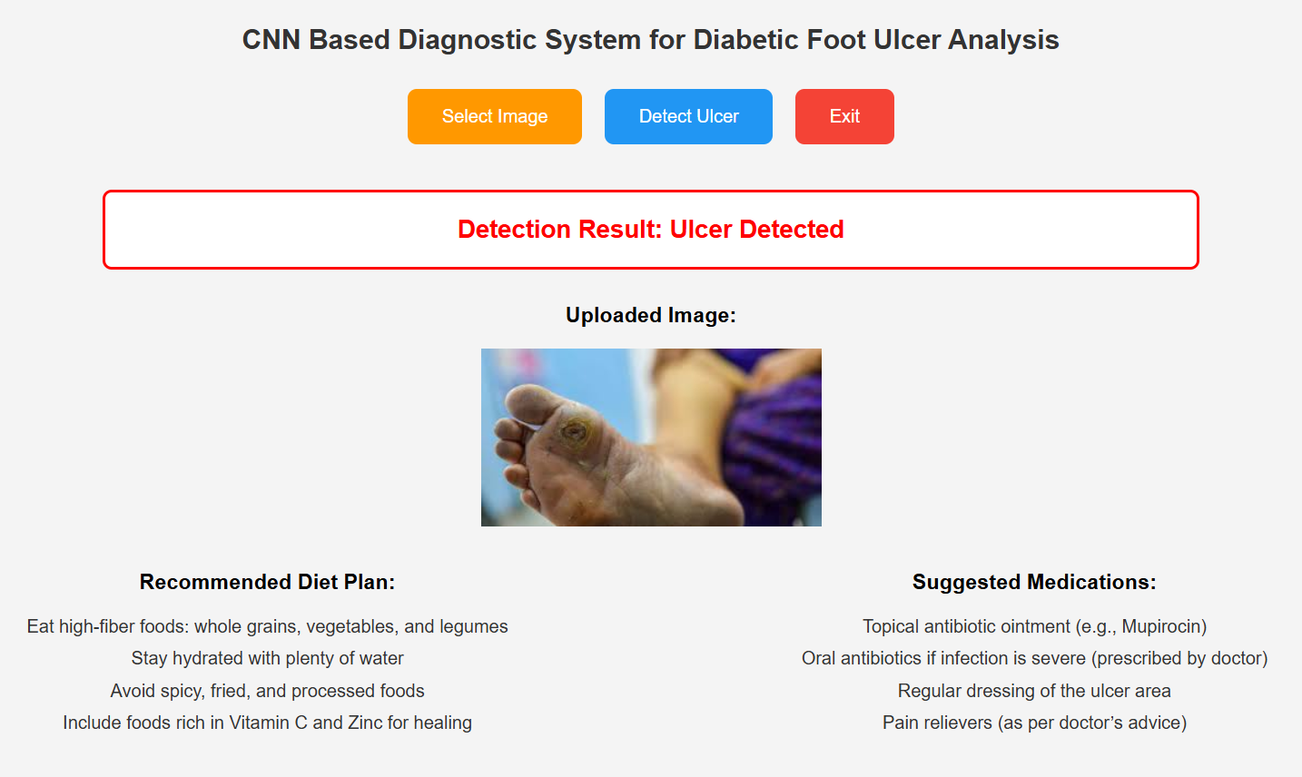
Results

Slide 19
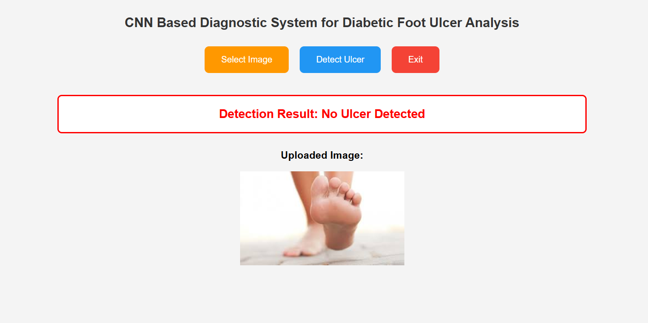

Slide 20
Conclusion
Effective Detection: The system accurately detects foot ulcers using image processing, ensuring early identification.
Real-Time Monitoring: The system offers real-time feedback, enhancing prompt intervention by healthcare providers or patients.
Potential Impact: This project has the potential to significantly improve diabetic foot care by facilitating early detection and timely treatment, preventing complications.

Slide 21
References
Boulton, A. J. M., et al. (2008). "Comprehensive foot examination and risk assessment." Diabetes Care, 31(8), 1679-1685.
Armstrong, D. G., et al. (2017). "Diabetic foot ulcers and their recurrence." Diabetes Care, 40(7), 1019-1028.
Srinivasan, S., et al. (2020). "Automated detection of diabetic foot ulcers using deep learning techniques." Journal of Diabetes Science and Technology, 14(4), 590-595.
Zhou, X., et al. (2020). "Deep learning-based diabetic foot ulcer detection system." IEEE Access, 8, 107291-107301.
Dhar, M. K., et al. (2024). "Wound tissue segmentation in diabetic foot ulcer images using deep learning: A pilot study." arXiv preprint arXiv:2406.16012.

Slide 22
Thank You

